Slide 1

LONGLIVE TEAM

Slide 2

REPORT
Content 01
Product introduction.
Content 02
Functions were completed.
Content 03
Develop application.

Slide 3
Product Introdution
It is photo storage and sharing website.
Languages and Technologies: java, javascrip, html, MySQL…
Framework: strust2

Slide 4
FUNCTION WERE COMPLETED
01
02
Signup
Login.
03
04
Upload picture
Add/Delete album
05
06
Change Profile
Comment

Slide 5
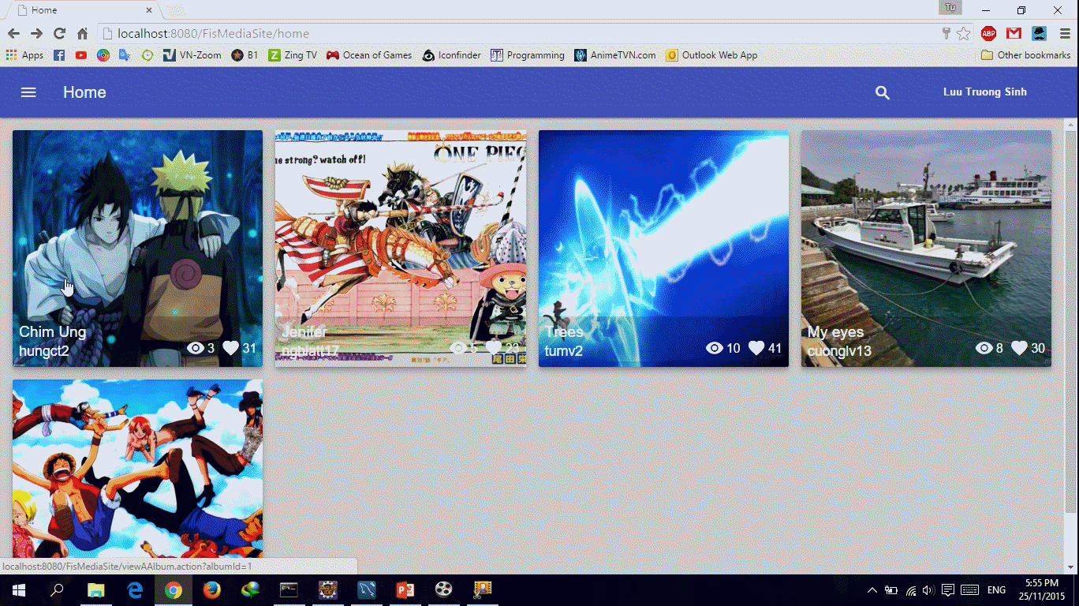
Homepage

Slide 6
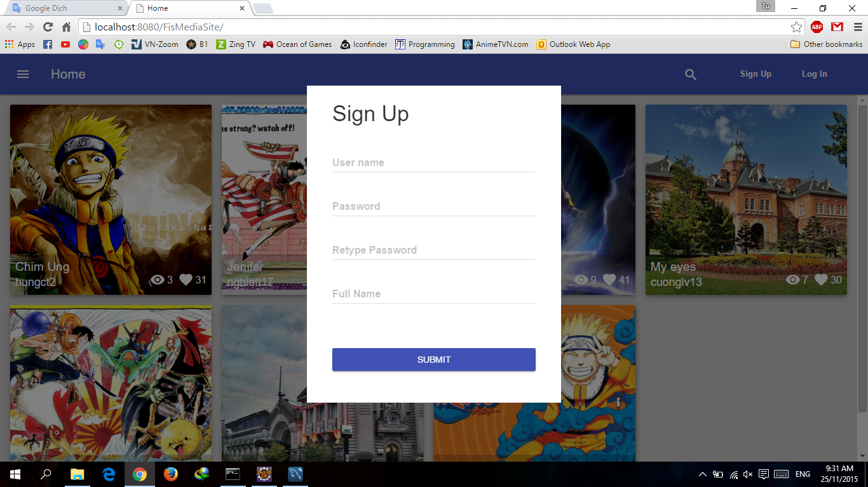
Signup

Slide 7
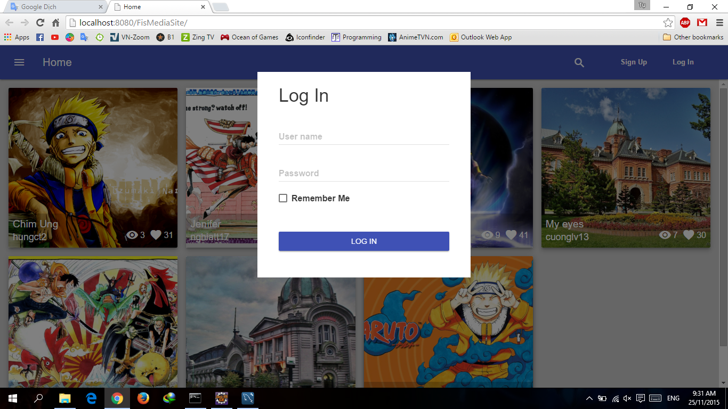
Login

Slide 8
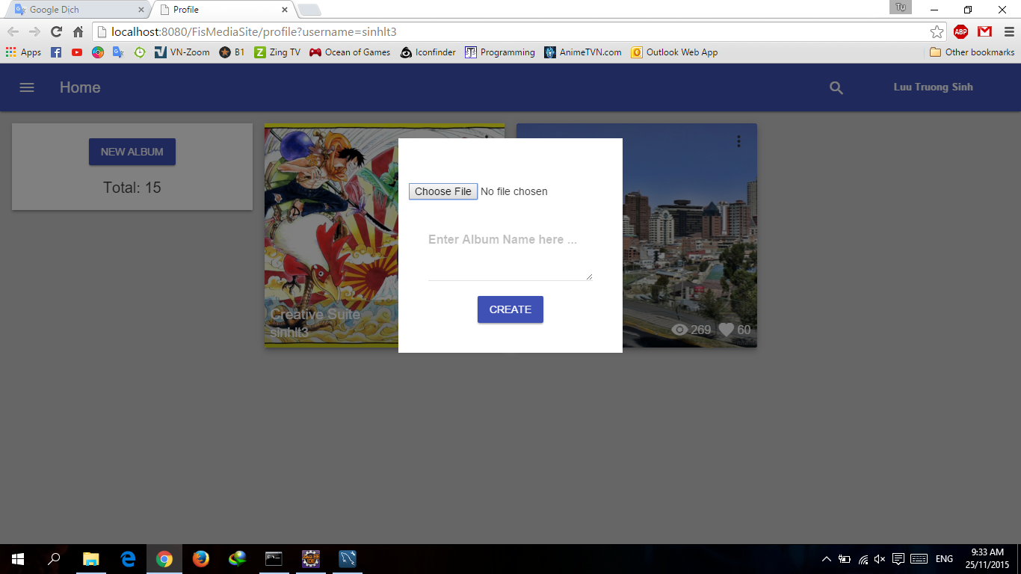
Create album

Slide 9
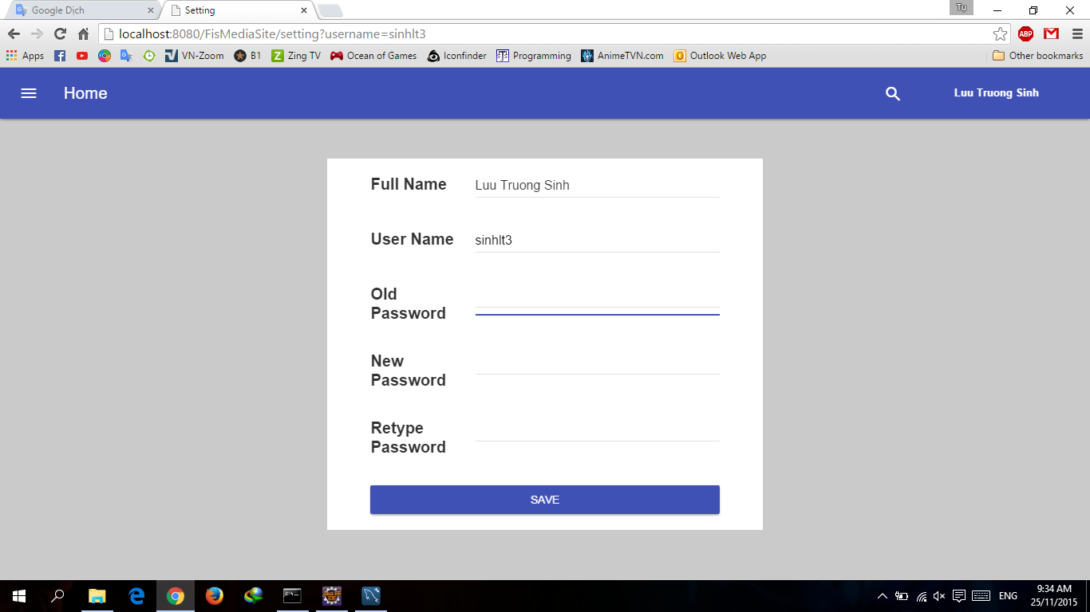
Change Password

Slide 10
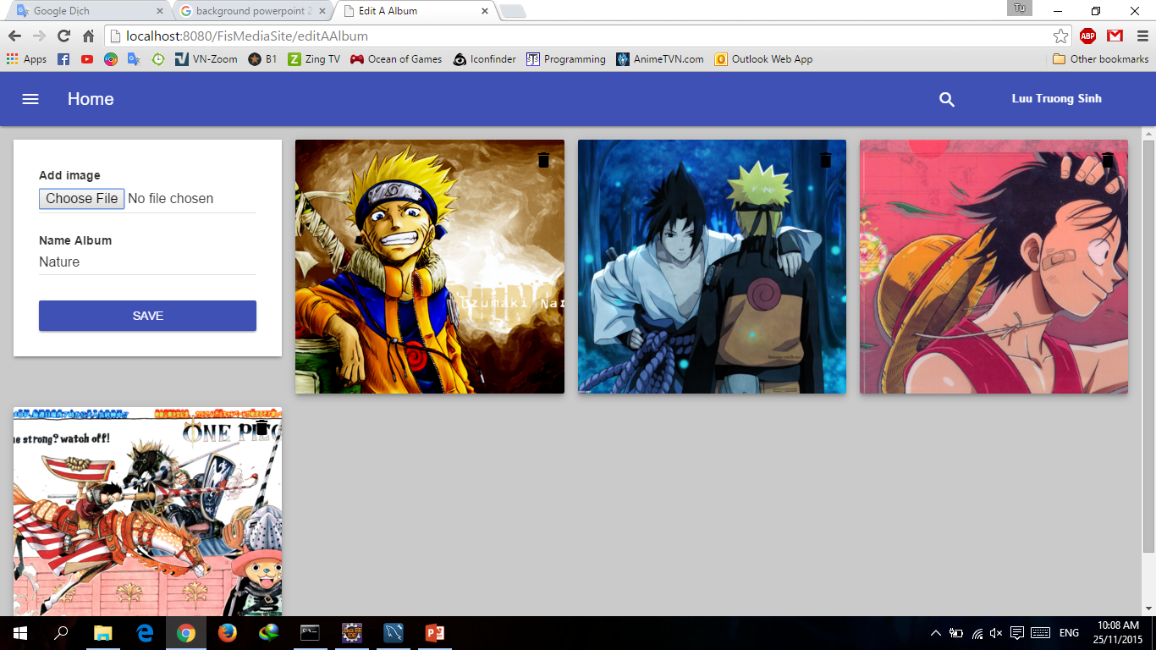
Add/Delete image from album

Slide 11
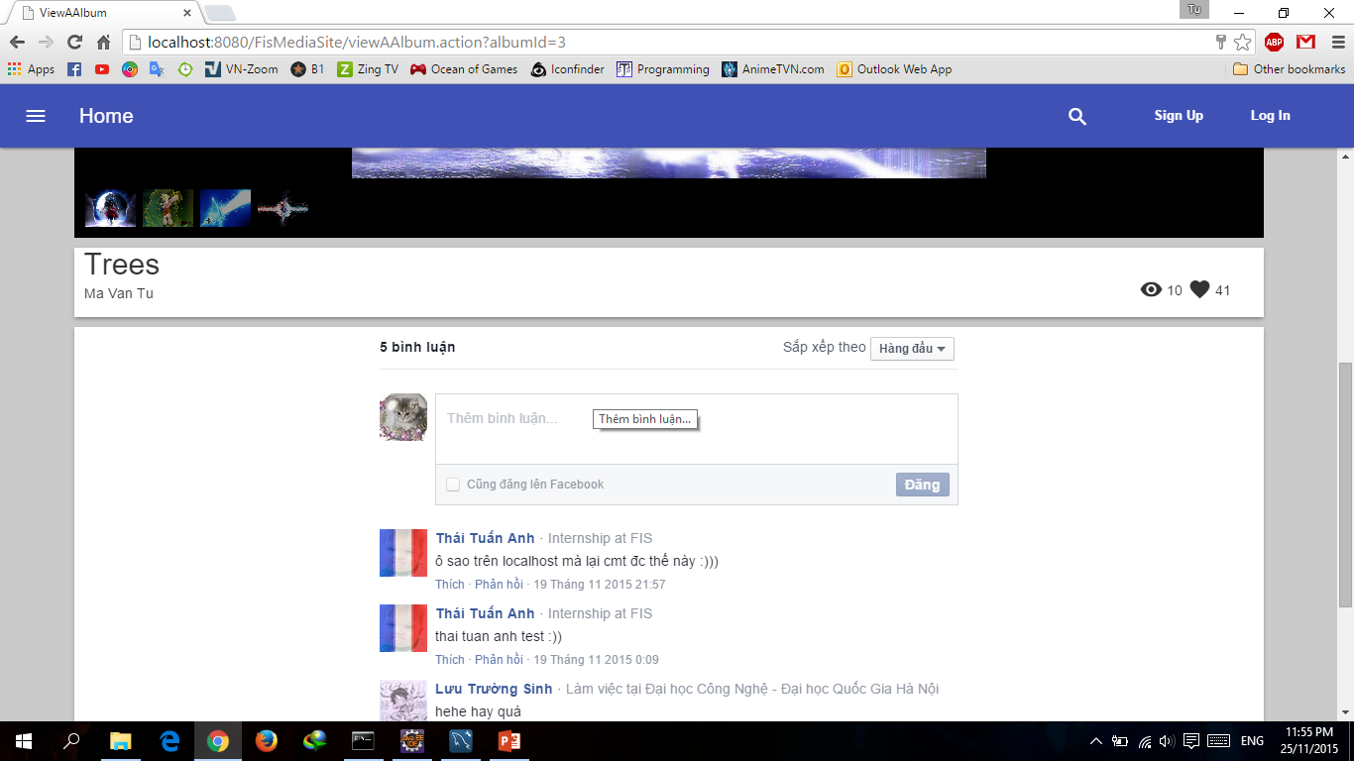
Comment

Slide 12
Develop Product
Team can add new function:
Add friend and Chat
Create Video and Slide picture

Slide 13
Longlive Team
Trần Tuấn Nghĩa
Lưu Trường Sinh
Chu Thành Hưng
Lê Cường
Ma Văn Tụ
Thái Tuấn Anh

Slide 14


THANH YOU!

